Slide 1
LECTURE 02 Predicate Logic

Slide 2
What you will learn in this lecture:
Predicates
Quantifiers
Universal Quantifier
Existential Quantifier
Translating from English into Logical Expressions
Logical Equivalences Involving Quantifiers
De Morgan’s Law for Quantified Statements
Nested Quantifiers Expression

Slide 3
What is Predicate Logic?
Predicate logic is also known as first order logic.
Recall that in English, when you have a sentence, it can be divided into two components: a subject and a predicate, where the predicate describes the subject.
In predicate logic, the predicate can be used to express the meaning and relationship of mathematical/computer science statements.
Quantification phrases are involved in a predicate for it to have a truth value.
The word some, all, every, each one are examples of quantification phrases in English.

Slide 4
The Quantifiers
Universal Quantifier
Existential Quantifier

Slide 5
Universal Quantifiers,
For any predicate, a universal quantifier expresses the English word “for every”, “for all”, or “for any”.
Example:
∀x Q(x) means “for all x , Q(x) is true” or “for every x , Q(x) is true”
∀x Q(x) is the same as Q(x₁) ∧ Q(x₂) ∧ Q(x₃) ∧ Q(x₄) ∧ … ∧ Q(x_{n})
(if the domain of discourse contains only x₁, x₂, …., x_{n})
If an x is causing Q(x) to be false, then the statement ∀x Q(x) is false.
The symbol ∀ is the universal quantifier.
Q(x) is the predicate.
x is the variable (subject).
Both alphabets of Q and x can be changed.
A domain of discourse
is the universal set
where the variable x lies, which
is also known as universe
of discourse.

Slide 6
Existential Quantifiers,
For any predicate, an existential quantifier expresses the English word “for some”, “there exist at least” , “for at least one”, or “there is”.
Example:
∃x Q(x) means “for some x , Q(x) is true” or “there is at least one x such that Q(x) is true”
∃x Q(x) is the same as Q(x₁) ∨ Q(x₂) ∨ Q(x₃) ∨ Q(x₄) ∨ … ∨ Q(x_{n})
(if the domain of discourse contains only x₁, x₂, …., x_{n})
If at least one x is causing Q(x) to be true, then ∃x Q(x) is true.
The symbol ∃ is the existential quantifier.
Q(x) is the predicate .
x is the variable (subject)
Both alphabets of Q and x can be changed.

Slide 7

Precedence of Quantifiers
The quantiﬁers ∀ and ∃ have higher precedence than all logical operators from propositional calculus.
For example, $∀xP(x) ∨ Q(x)$is the disjunction of $∀xP(x)$and $Q(x)$. In other words, it means $(∀xP(x)) ∨ Q(x)$rather than $∀x(P(x)∨ Q(x)).$

Slide 8
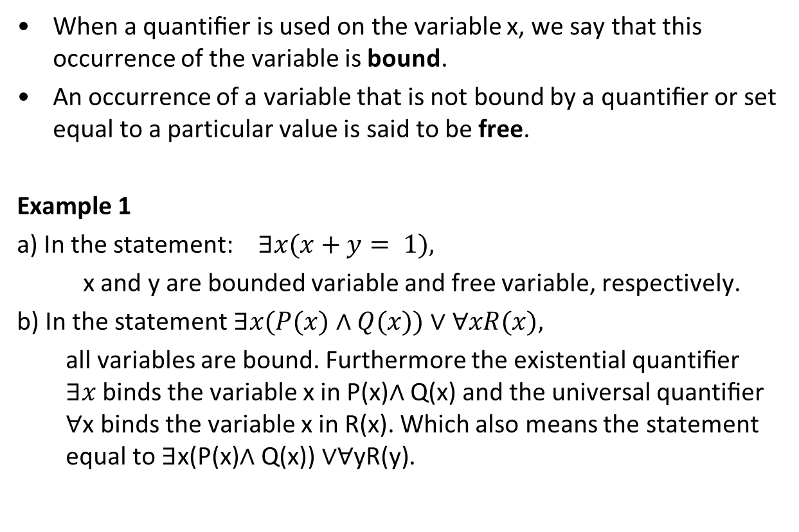
Binding Variables
When a quantiﬁer is used on the variable x, we say that this occurrence of the variable is bound.
An occurrence of a variable that is not bound by a quantiﬁer or set equal to a particular value is said to be free.
Example 1
a) In the statement: $∃x(x+y= 1),$
x and y are bounded variable and free variable, respectively.
b) In the statement $∃x(P(x)∧Q(x))∨∀xR(x),$
all variables are bound. Furthermore the existential quantiﬁer $∃x$binds the variable x in P(x)∧ Q(x) and the universal quantiﬁer ∀x binds the variable x in R(x). Which also means the statement equal to $\text{∃}\text{x}\text{(}\text{P}\text{(}\text{x}\text{)∧ }\text{Q}\text{(}\text{x}\text{)) ∨∀}\text{y}\text{R}\text{(}\text{y}\text{)}\text{.}$

Slide 9
Truth Value
As with propositions, the truth value for the predicates can be evaluated.
To conclude that a statement of the form ∃x Q(x) is true, we need to only find one value of x in the universe of discourse for which Q(x) is true.
To conclude that a statement of the form ∀x P(x) is false, we need to only find one value of x in the universe of discourse for which P(x) is false. Such a value of x is called the counter example to the statement ∀x P(x).

Slide 10
Example 2
Given a predicate,
Q(x): x² > 10.
What is the truth value of ∃x Q(x), if the domain of discourse consists the numbers of 0, 1, 2, 3, and 4?
The universe of discourse contains the number 4. Since Q(4), which is the statement “16 > 10” is true, therefore ∃x Q(x) is true.
This is an evaluation for truth value of an existential statement.
So find one x value that makes the predicate statement to be true to show that the quantified statement as a whole to be true.
How about the statement ∀x Q(x)?
Is it True or False?
If False, what is the counter example?

Slide 11
Example 3
Given that the domain of discourse consists of all integers, what is the truth value of ∀x (x is even)?
If your answer is false, give a counter example.
Statement is false.
Counter example: x = 1.
Can you think of other counterexamples?

Slide 12
Example 4
Determine the truth value of the following statements.
If the statement is false, explain why.
Assume that:
the domain of discourse for x is the set of real numbers
the set of all positive real numbers
the set of integers
the set of positive integers
∀x (2x ≥ x) (b) ∃x (x³ = −1) (c) ∃x (x² = −1)
Solution:
The statement is true for (ii) and (iv), false for (i) and (iii). Counterexample: x = −1, 2x = −2 < −1 = x.
The statement is true for (i) and (iii), false for (ii) and (iv), since the only solution (in real numbers) to the equation x³ = −1 is x = −1 (integers are real numbers too).
The statement is always false, since for all real number s or integers, x, x² ≥ 0 (we can never get a negative value).

Slide 13
Translate quantified English statements
Quantified English statements can be translated into predicates with quantifiers ∀, ∃ and with logical connectives such as ∧, ∨, ¬, →, ↔.
There can be more than one variable for a predicate, such as P(x) , Q(x,y) or R(x, y, z, …) depending on the English statements.
Example
P(x, y): x eats y
What is the truth value for P(cow, grass)? How about P(cow, cat)?
Quantified statements for predicates with more that one variable may involve more that one quantifiers (more to come).

Slide 14
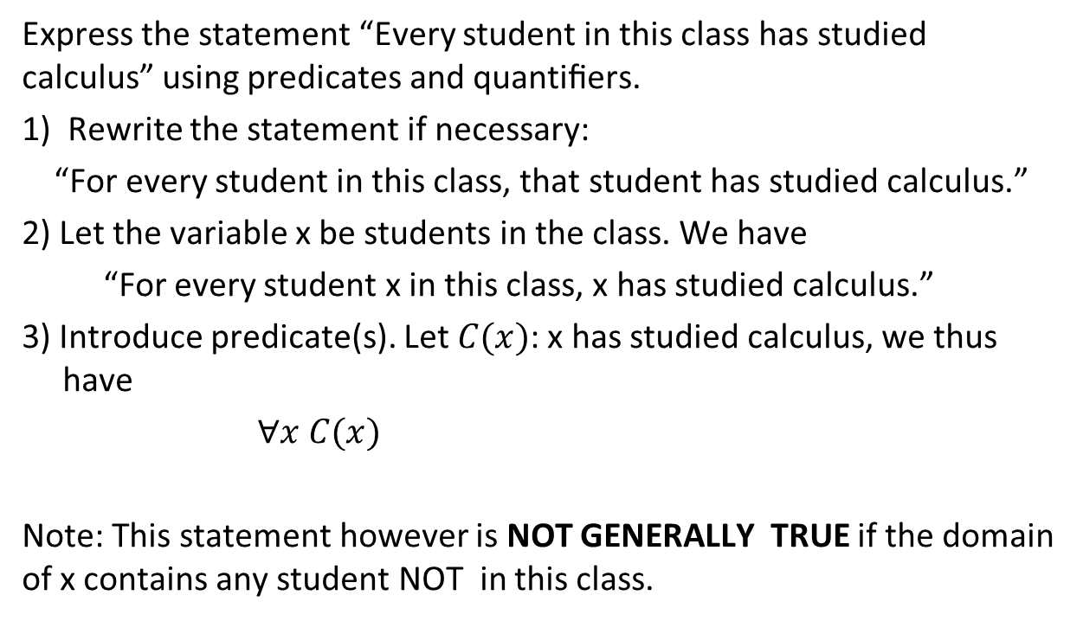
Example 5
Express the statement “Every student in this class has studied calculus” using predicates and quantiﬁers.
1) Rewrite the statement if necessary:
“For every student in this class, that student has studied calculus.”
2) Let the variable x be students in the class. We have
“For every student x in this class, x has studied calculus.”
3) Introduce predicate(s). Let $C(x)$: x has studied calculus, we thus have
$∀x C(x)$
Note: This statement however is NOT GENERALLY TRUE if the domain of x contains any student NOT in this class.

Slide 15
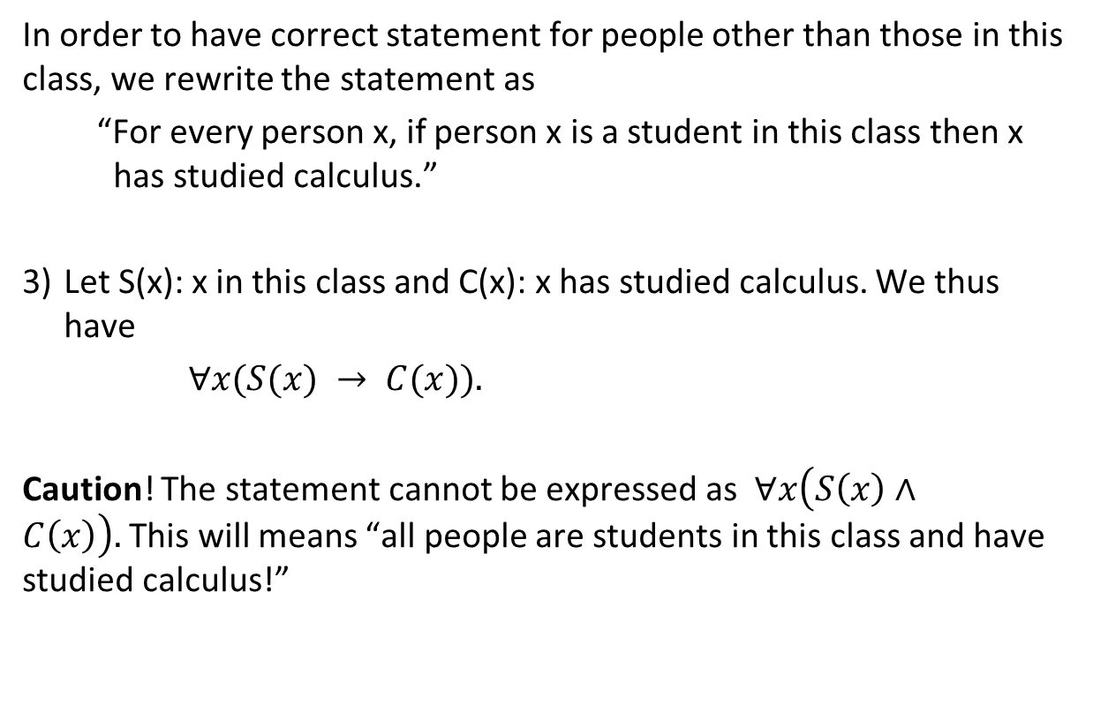
Example 5 (Cont.)
In order to have correct statement for people other than those in this class, we rewrite the statement as
“For every person x, if person x is a student in this class then x has studied calculus.”
3) Let S(x): x in this class and C(x): x has studied calculus. We thus have
$∀x(S(x) → C(x)).$
Caution! The statement cannot be expressed as $∀x\left(S\left(x\right)∧C\left(x\right)\right).$This will means “all people are students in this class and have studied calculus!”

Slide 16
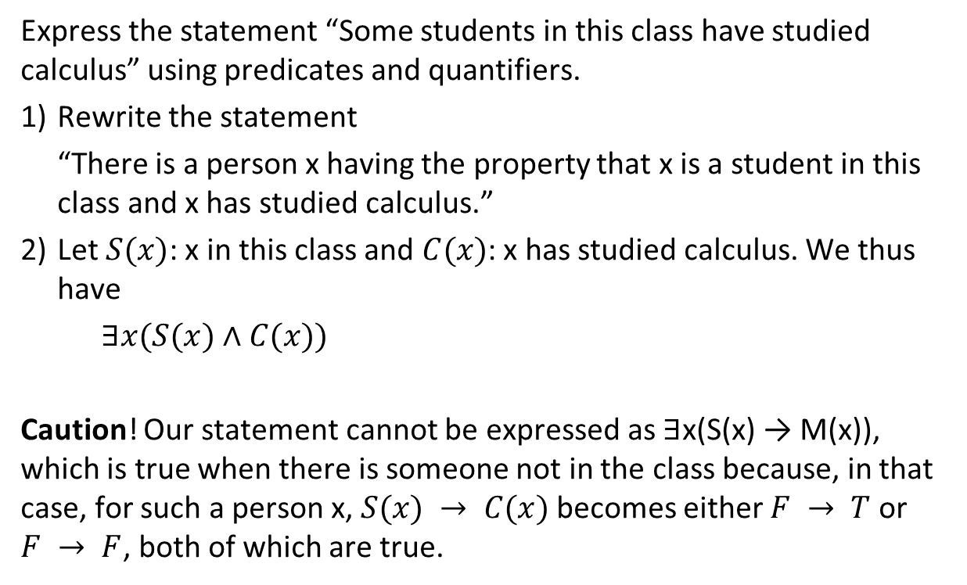
Example 6
Express the statement “Some students in this class have studied calculus” using predicates and quantifiers.
Rewrite the statement
“There is a person x having the property that x is a student in this class and x has studied calculus.”
2) Let $S(x)$: x in this class and $C(x)$: x has studied calculus. We thus have
$∃x(S(x)∧C(x))$
Caution! Our statement cannot be expressed as ∃x(S(x) → M(x)), which is true when there is someone not in the class because, in that case, for such a person x, $S(x) → C(x)$ becomes either $F → T$ or $F → F$, both of which are true.

Slide 17
Example 7
Let S(x): x is a subject in MMU and T(x): x is a tough subject.
Translation:
Some subjects in MMU is tough. ∃x (S(x) ∧ T(x))
No subject in MMU is tough. ¬ ∃x (S(x) ∧ T(x))
OR ∀x (S(x) → ¬ T(x))
All subjects in MMU are tough. ∀x (S(x) → T(x))
Not all subjects in MMU are tough. ¬ ∀x (S(x) → T(x))
OR ∃x (S(x) ∧ ¬ T(x))

Slide 18
Logically equivalent
Definition: Logically equivalent
Statements involving predicates and quantiﬁers are logically equivalent if and only if they have the same truth value no matter which predicates are substituted into these statements and which domain of discourse is used for the variables in these propositional functions.
We use the notation S ≡ T to indicate that two statements S and T involving predicates and quantiﬁers are logically equivalent.

Slide 19
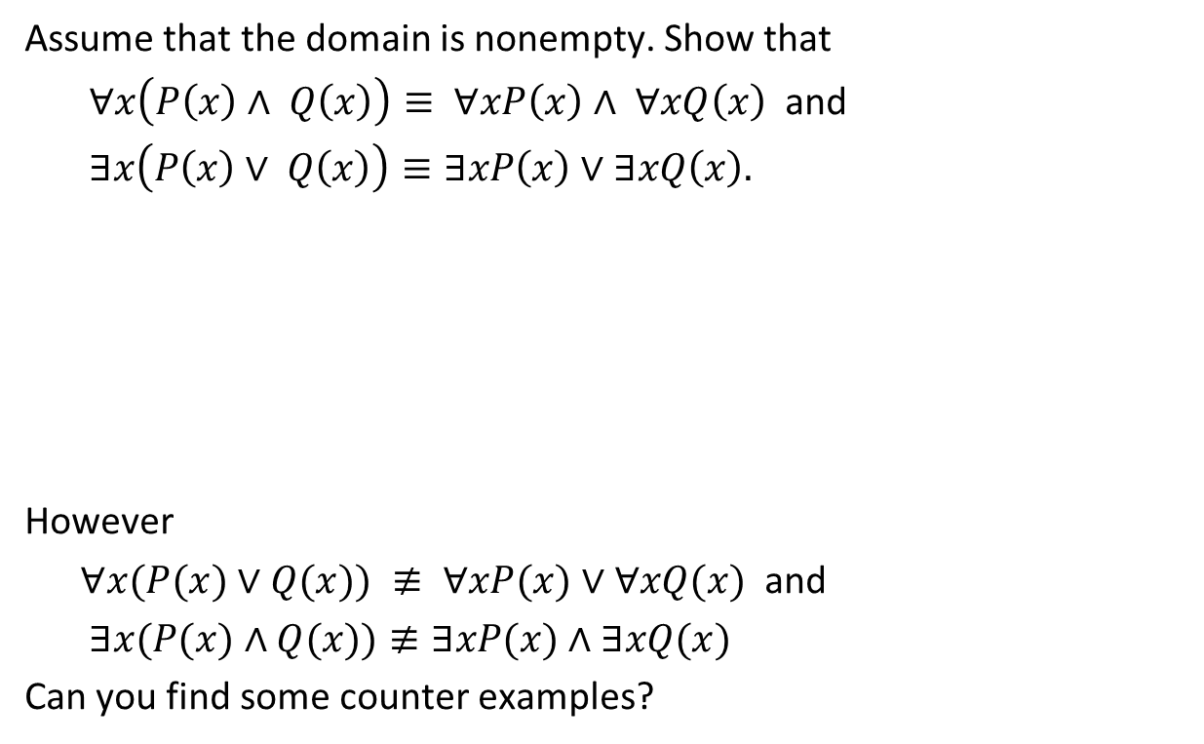
Example 8
Assume that the domain is nonempty. Show that
$∀x\left(P\left(x\right)∧ Q\left(x\right)\right)≡ ∀xP\left(x\right)∧ ∀xQ\left(x\right)$ and
$∃x\left(P\left(x\right)∨ Q\left(x\right)\right)≡∃xP\left(x\right)∨∃xQ\left(x\right).$
However
$∀x(P(x)∨Q(x)) ≢ ∀xP(x)∨∀xQ(x)$ and
$∃x(P(x)∧Q(x))≢∃xP(x)∧∃xQ(x)$
Can you find some counter examples?

Slide 20
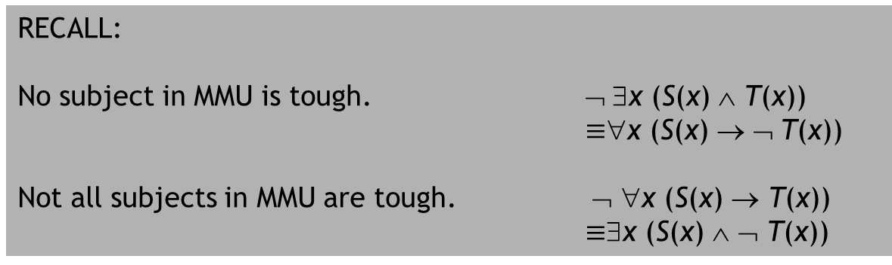
Negating quantified statements using De Morgan’s Law
Whenever negation (¬) occurs before a quantified statement, the De Morgan’s Law for Quantifiers can be used to write an equivalent statement.
Negation | Equivalent Statement
¬∃x P(x) | ∀x ¬P(x)
¬∀x P(x) | ∃x ¬P(x)
RECALL:
No subject in MMU is tough. ¬ ∃x (S(x) ∧ T(x))
$≡$∀x (S(x) → ¬ T(x))
Not all subjects in MMU are tough. ¬ ∀x (S(x) → T(x))
$≡$∃x (S(x) ∧ ¬ T(x))

Slide 21
Example 9
P(x): x is a student of TMA1201 from MMU’s Fosee.
∀xP(x)
¬∀xP(x)
∃x ¬P(x)
“Every student of TMA1201 is from MMU’s Fosee.”
The negation of the statement is
“Not every student of TMA1201 is from MMU’s Fosee.”,
which is the same as
“There is a student of TMA1201 that is not from MMU’s Fosee”.

Slide 22
Example 10
P(x): x is a man taller than 3 meters.
∃xP(x)
¬∃xP(x)
∀x ¬ P(x)
“There is a man taller than 3 meters.”
The negation of the statement is
“There does not exist a man taller than 3 meters.”,
which is the same as
“Every man is not taller than 3 meters.”.

Slide 23
Nested Quantifiers
For a predicate with two or more variables, we can have two or more quantifiers to describe the quantity of these variables. There can be 6 possible combinations as below:
Statement | Meaning
∀x ∀y P(x, y) ∀y ∀x P(x, y) | P(x, y) is true for every pair of x, y.
∀x ∃y P(x, y) | For every x there is a y for P(x, y) to be true.
∃x ∀y P(x, y) | There is an x for every y for P(x, y) to be true.
∃x ∃y P(x, y) ∃y ∃x P(x, y) | There exist at least a pair of x, y for P(x, y) to be true.

Slide 24
Order of Quantifiers
The order of these quantifiers gives different meaning to the statement.
Given that F(x, y): x and y are friends.
The domain of discourse is all the students in MMU.
Translate the following statements into English.
∀x ∃y F(x, y)
∃x ∀y F(x, y)
∃x ∀y ∀z (F(x, y) ∧ F(x, z) ∧ (y ≠ z) → ¬F(y, z))
∀x ∃y ∃z (F(x, y) ∧ F(x, z) ∧ (y ≠ z) ∧ ¬F(y, z))

Slide 25
Solution:
Given that F(x, y): x and y are friends.
The domain of discourse is all the students in MMU.
Translate the following statements into English.
∀x ∃y F(x, y)
Every students in MMU has some friends.
∃x ∀y F(x, y)
There is a student in MMU who is a friend to all students in MMU.
∃x ∀y ∀z (F(x, y) ∧ F(x, z) ∧ (y ≠ z) → ¬F(y, z))
There is a student in MMU where none of his/her friends are friends to each other.
∀x ∃y ∃z (F(x, y) ∧ F(x, z) ∧ (y ≠ z) ∧ ¬F(y, z))
Every students in MMU has at least two friends where these two friends are not friends to each other.

Slide 26
Order of Quantifiers and Truth Value
The order of these quantifiers whenever they differ gives different truth values.
Example
Translate the following two statements into English
a) ∀x ∃y (x + y = 0)
b) ∃y ∀x (x + y = 0)
Do they express the same thing? Here the domain of discourse is the set of real numbers.
For every real number x, there exists a real number y such that their sum x + y is zero.
There exists a real number y, such that its sum with any real number x is zero.
The two statements do not express the same thing. In fact, the first one is true, and the second one is false.

Slide 27
Example 11
If the domain of discourse is the set of real numbers, determine the truth value of the following statements:
∀x ∃y x² = y
∃x ∀y (xy = 0)
∀x ∃y (x + 2y = 3)
a) True. Why?
b) True. x = 0.
d) True. y = (3−x)/2.

Slide 28
In Class Exercise
Given that Q(x, y) : x = y² where the domain of discourse is the set of integer, determine the truth value of the following statements and Justify each of your answer.
∀y Q(3, y)
∃y Q(3, y)
∀y Q(3, y) → ∃y Q(3, y)
∀x Q(x, 3)
∃x Q(x, 3)
∀x Q(x, 3) → ∃x Q(x, 3)
∃x Q(x, 3) → ∀x Q(x, 3)
∀x ∃y Q(x, y)
∃x ∀y Q(x, y)

Slide 29
Summary
We have discussed the following concepts related to predicate logic:
Meaning of predicates with universal quantifiers and existential quantifiers
Evaluating the truth values of statements with predicates.
Translation of quantified English statements into predicates with quantifiers and logical connectives.
Conversion of a negated predicate statements by De Morgan’s Law.
Order of quantifiers are important whenever two or more quantifiers are involved.

Slide 30
Exercise 1
Lets define the following predicate on the set of integer,
P(x): “x % 4 == 0”
Evaluate
P(8)
P(9)
(c) P(123464)
(d) ∀x P(x)
(e) ∃x P(x)
a % b is the remainder when a is divided by b

Slide 31
Exercise 2
Determine the truth value of each of the following statements.
If it is false, find a counterexample. Consider the case where the domain of discourse is
the set of real numbers
the set of integers for
(a) ∀x (x² ≠ x) (b) ∀x (x² ≠ 2) (c) ∀x (|x| > 0).

Slide 32
Exercise 3
Establish these logical equivalences, where x does not occur as a free variable in A. Assume that the domain is nonempty.
a) ∀x(A → P(x))≡ A →∀xP(x)
b) ∀x(P(x) → A) ≡∃xP(x) → A

Slide 33
Exercise 4
Use the following predicates
S(x): “x is student”
P(x): “x is always punctual”
L(x, y): “x likes y”
to express these sentences in first order logic.
a) There is a student who is always punctual.
b) All students are always punctual.
c) Some students are not always punctual.
d) There is a student who does not like punctual students.
The last one is trickier, but the first three you should have correctly.
Remember the clear rule about ∃ and ∀.

Slide 34
Exercise 5
Translate each of the following statements into logical expressions using predicates, quantifiers, and logical connectives. The domain of discourse is all the people in this world
No one is perfect.
Not everyone is perfect.
All your friends are perfect.
One of your friends is perfect.
Everyone is your friend and is perfect.
Not everyone is your friend or someone is not perfect.

Slide 35
Let P(x): x is perfect, F(x): x is your friend. (a) ¬∃x P(x) ∀x ¬P(x) (b) ¬∀x P(x) ∃x ¬P(x) (c) ∀x (F(x) → P(x)) (d) ∃x (F(x) ∧ P(x)) (e) ∀x F(x) ∧ ∀x P(x) ∀x (F(x) ∧ P(x)) (f) ¬∀x F(x) ∨ ∃x ¬P(x) ∃x ¬F(x) ∨ ∃x ¬P(x) ∃x (¬F(x) ∨ ¬P(x)) ∃x ¬(F(x) ∧ P(x))

